Slide 1
2017 Annual General Meeting

Slide 2
Agenda
2015 AGM Minutes
Operational Update:
  Timeline
  Away Rate
  Membership
2016 Financial Statements
Connecting Canadian Project Update
Formal Business: Directors + Resolutions 1-6
Adjournment

Slide 3
2015 AGM MINUTES
FOR APPROVAL

Slide 4
ESIS AT WORK
OPERATIONAL UPDATE

Slide 5
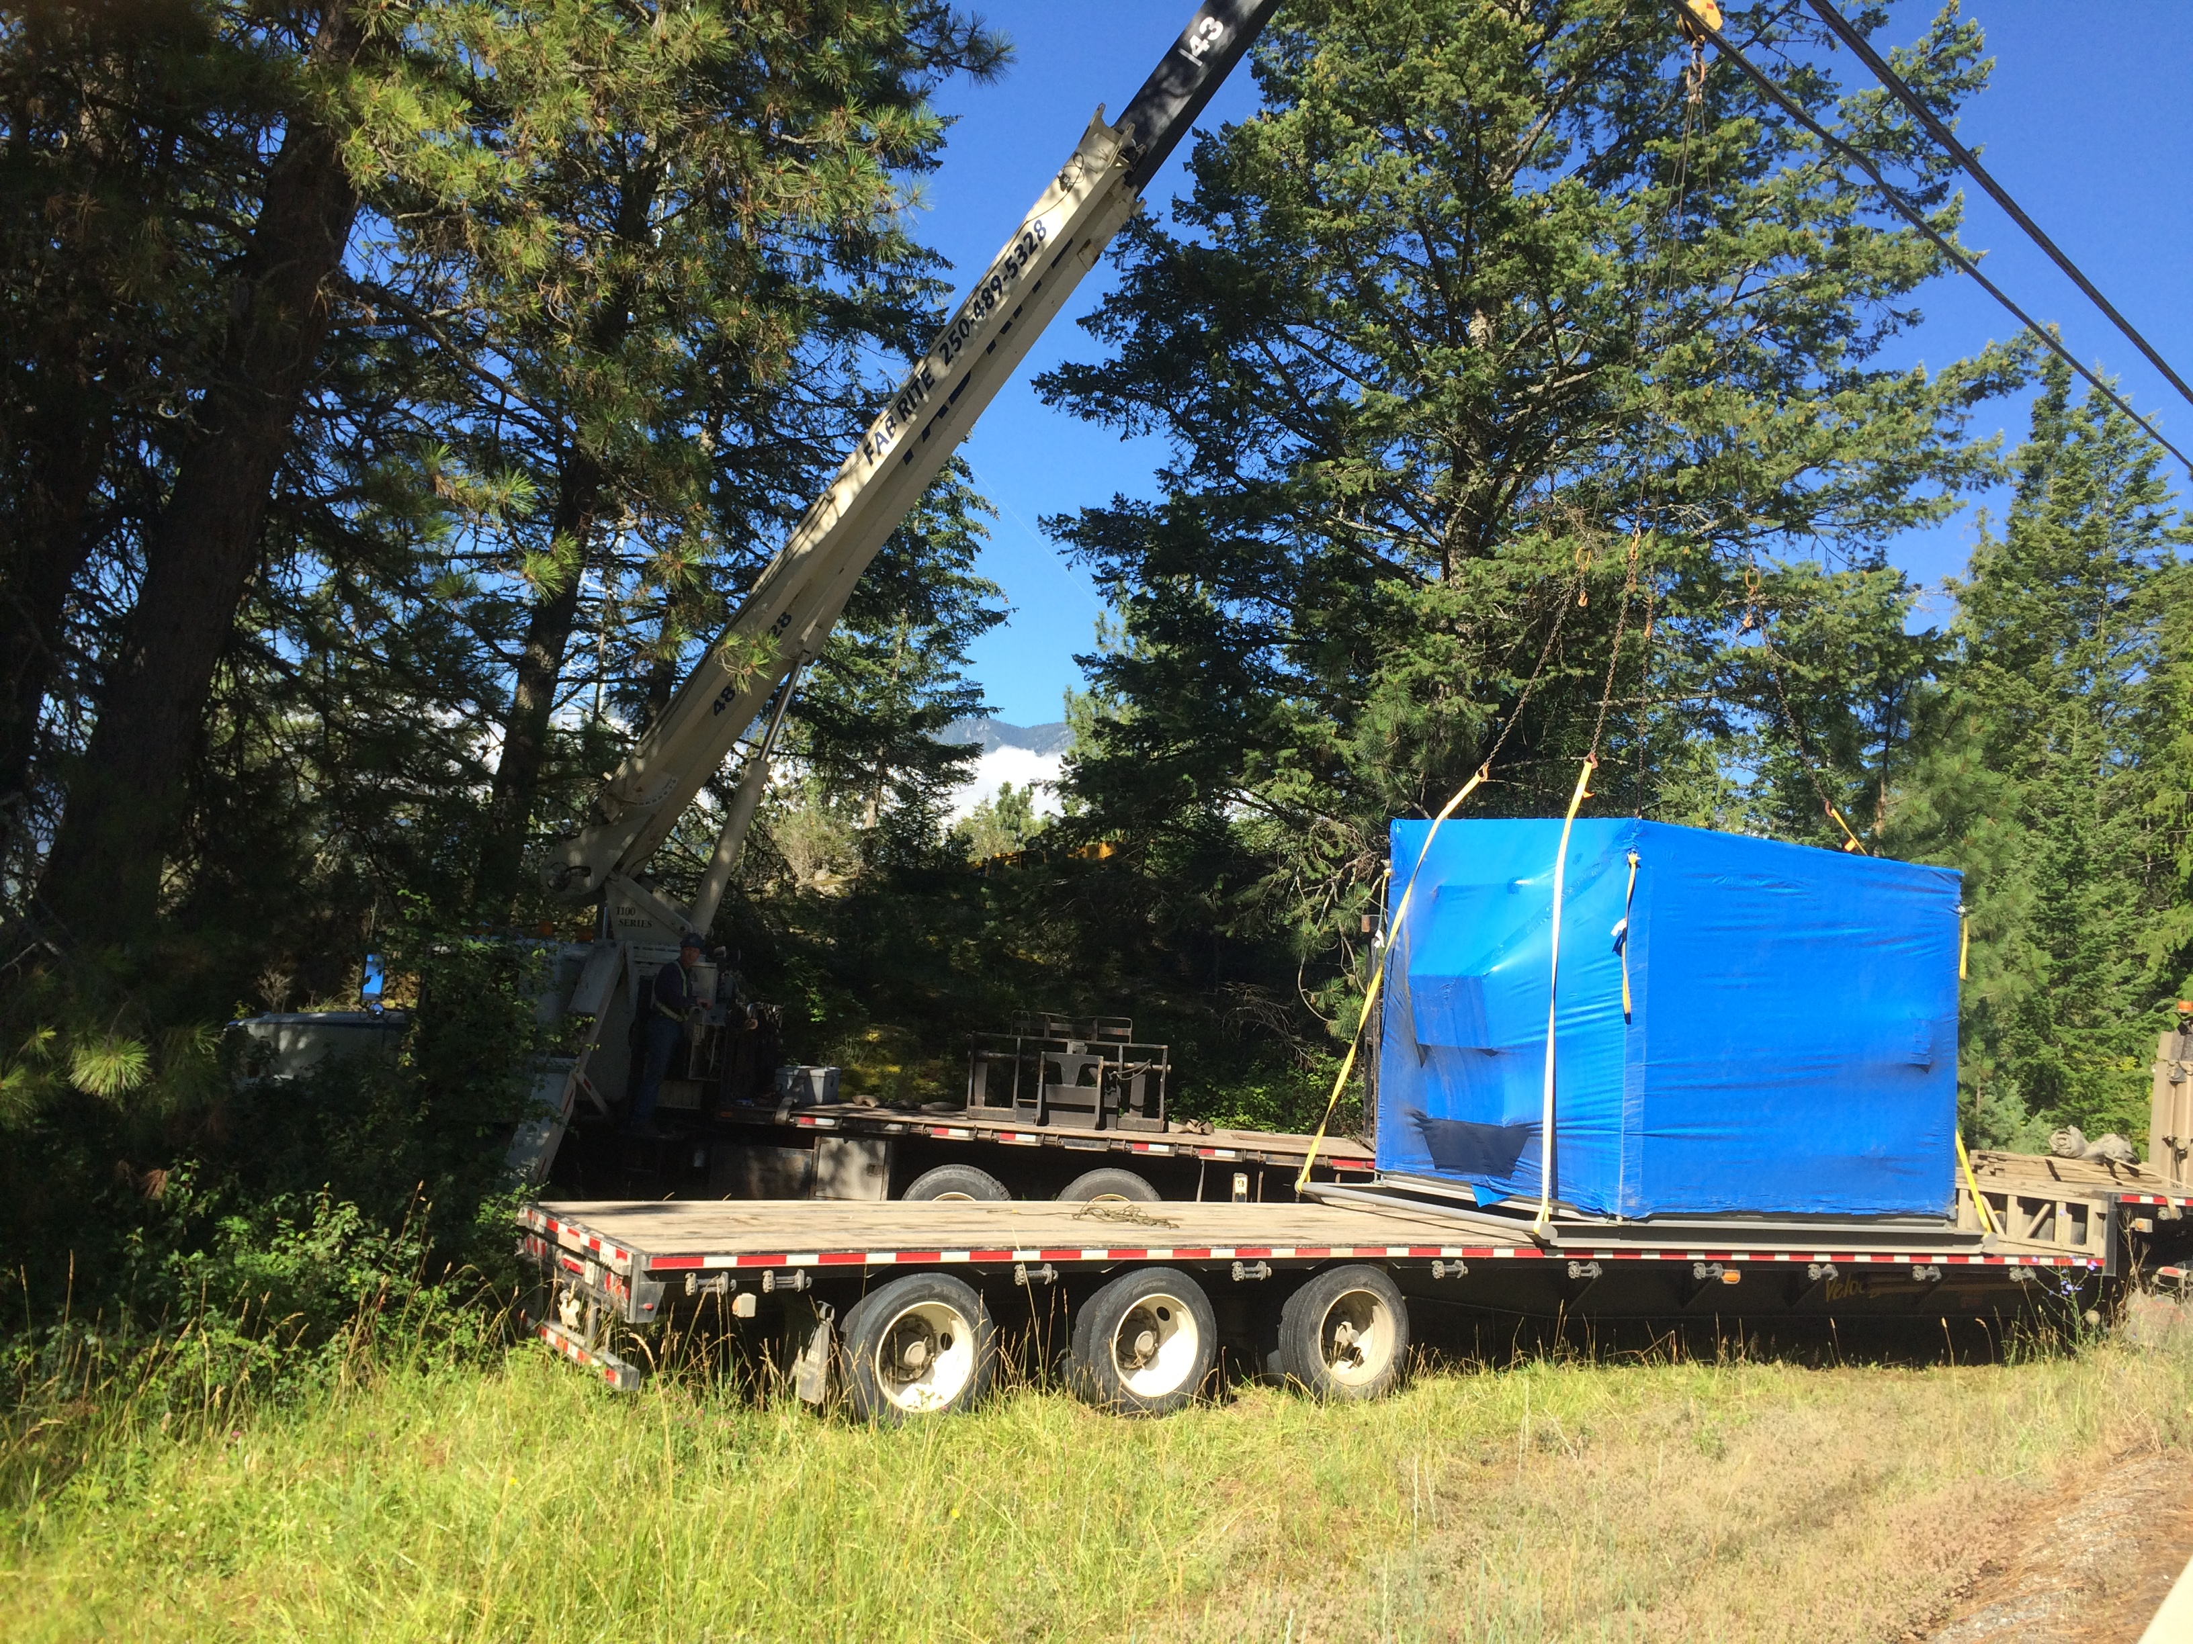
BLUE POINT FIBRE BLDG

Slide 6
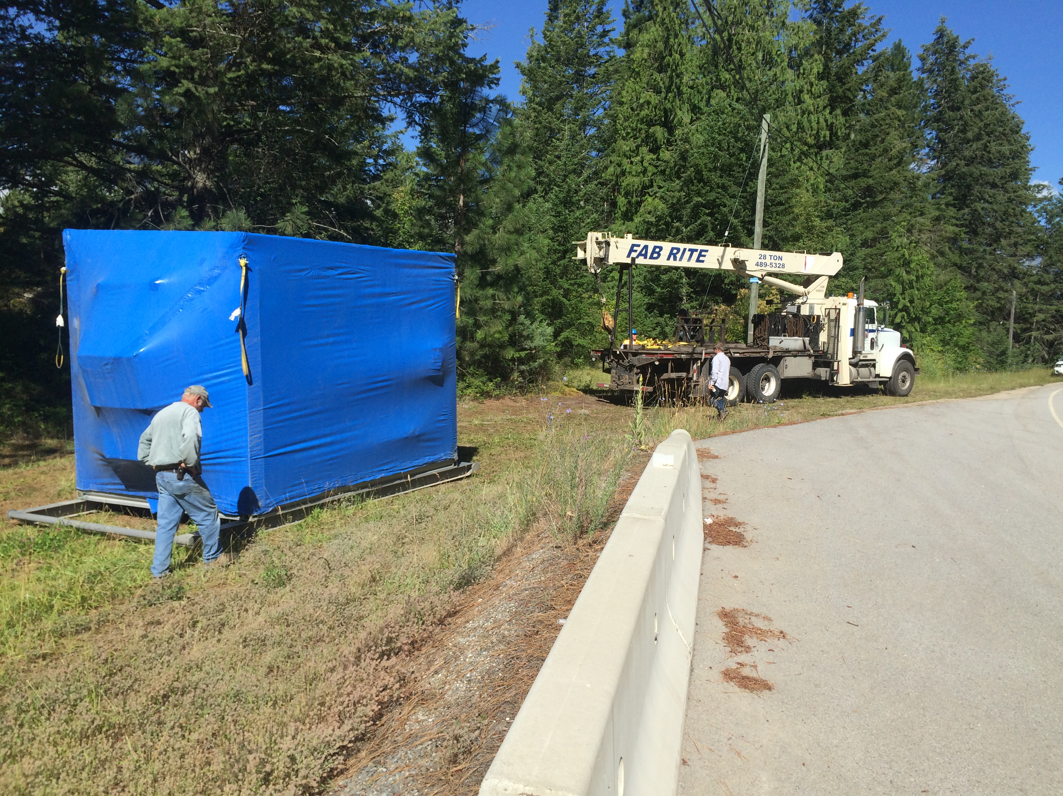

Slide 7
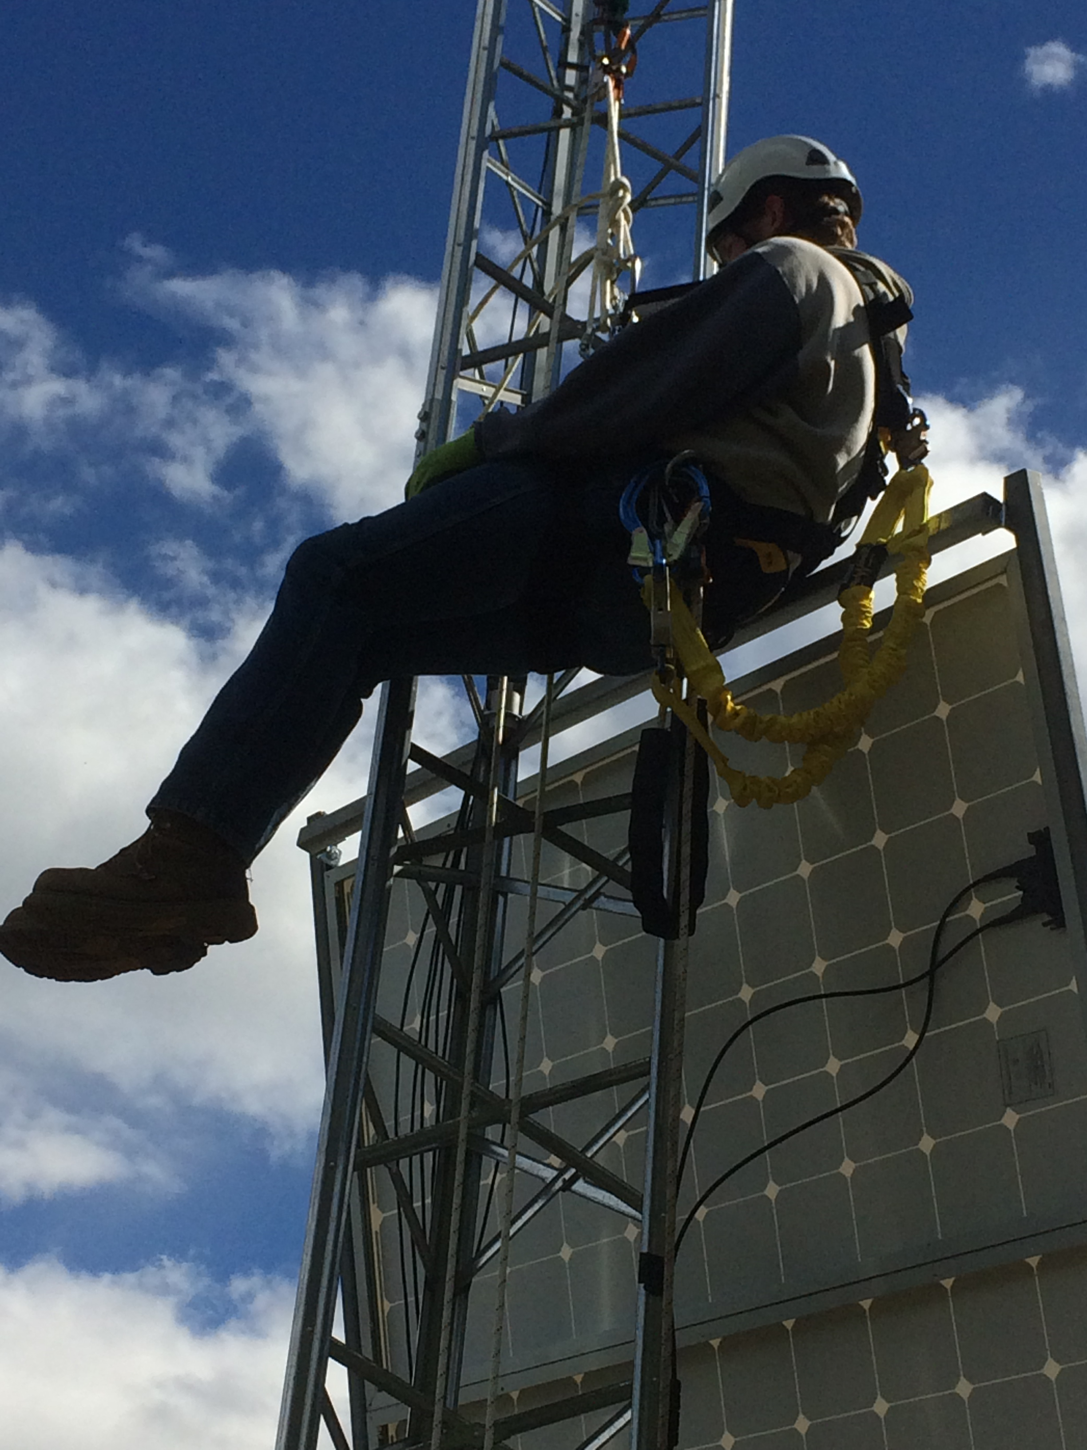
Tower rescue course

Slide 8


Slide 9
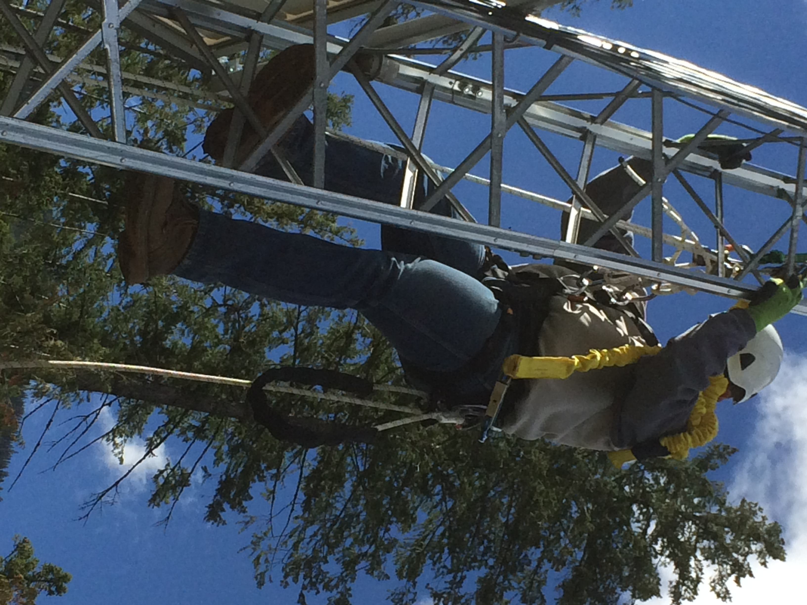

Slide 10
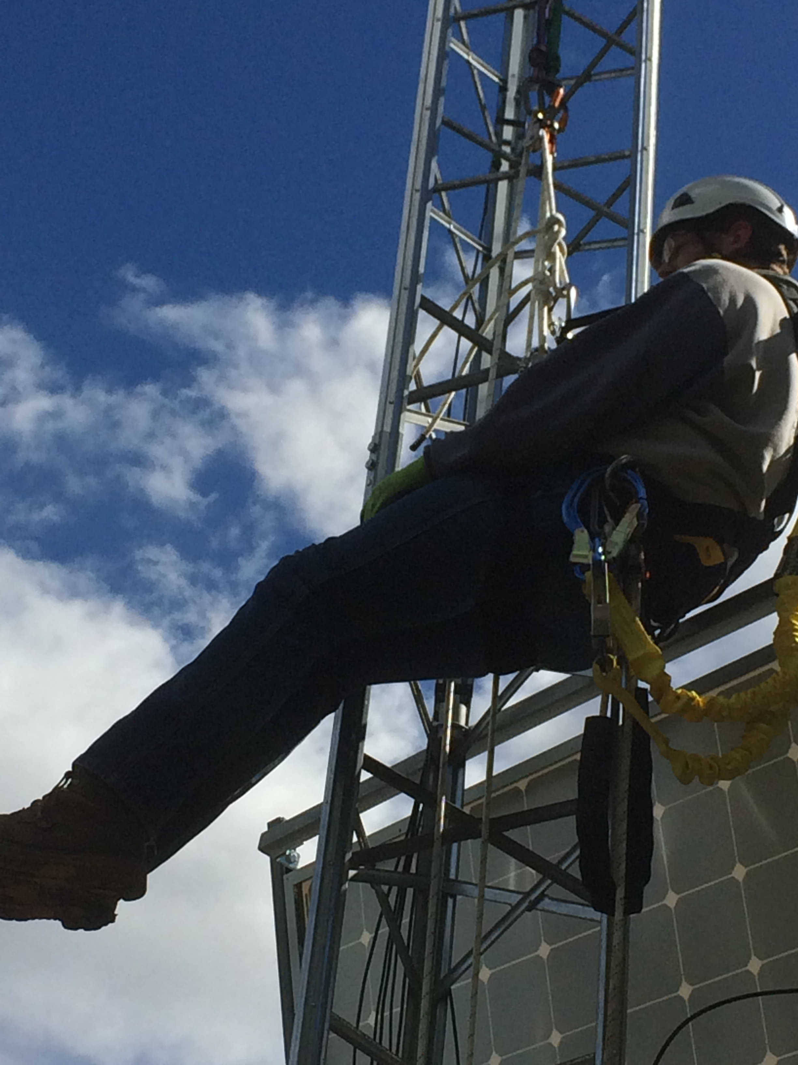

Slide 11
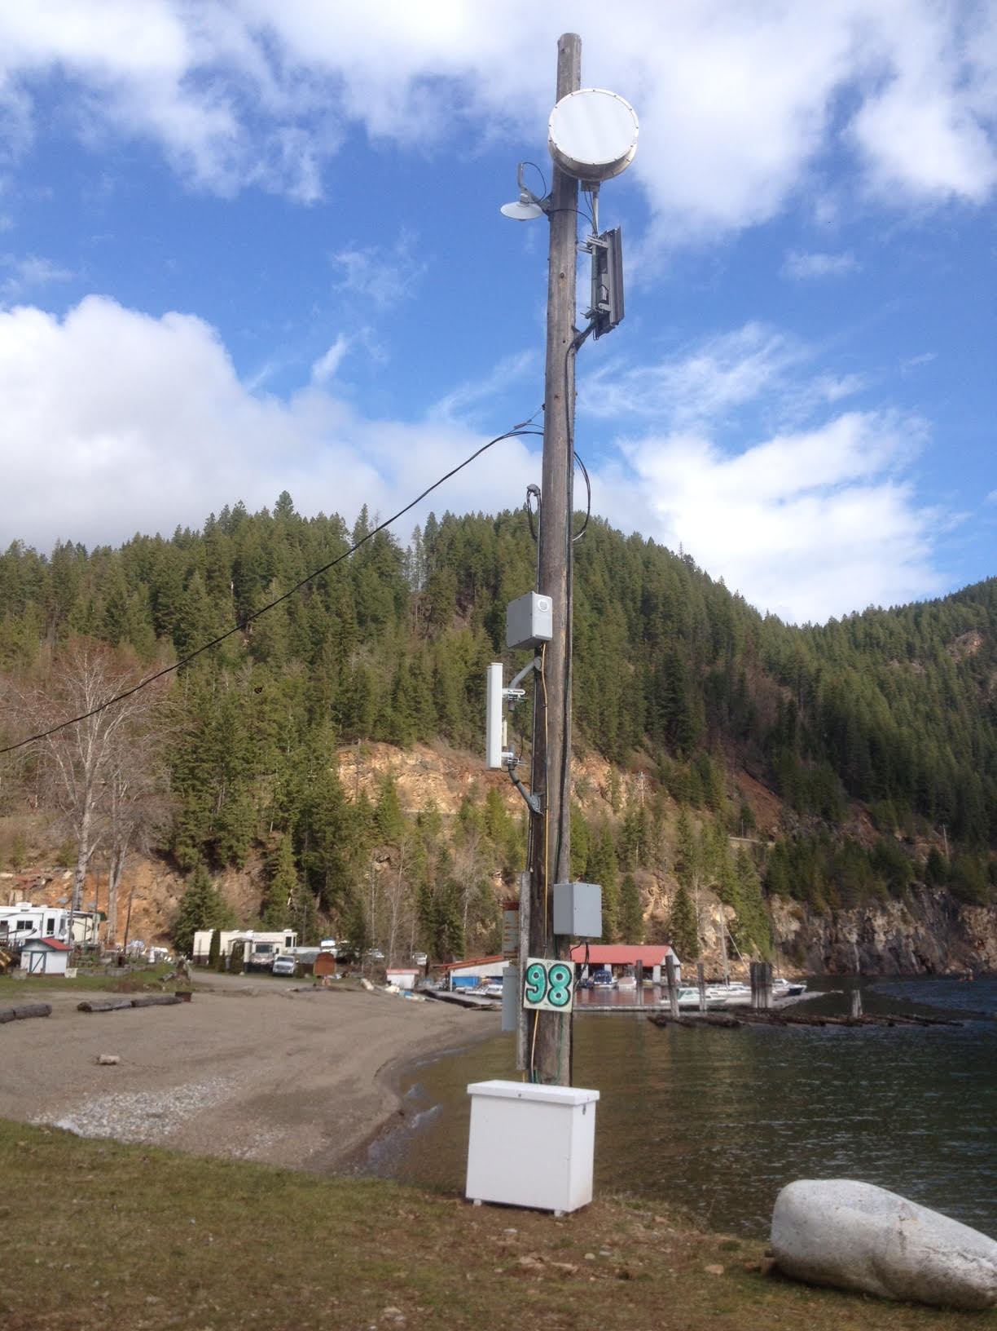
Woodbury

Slide 12
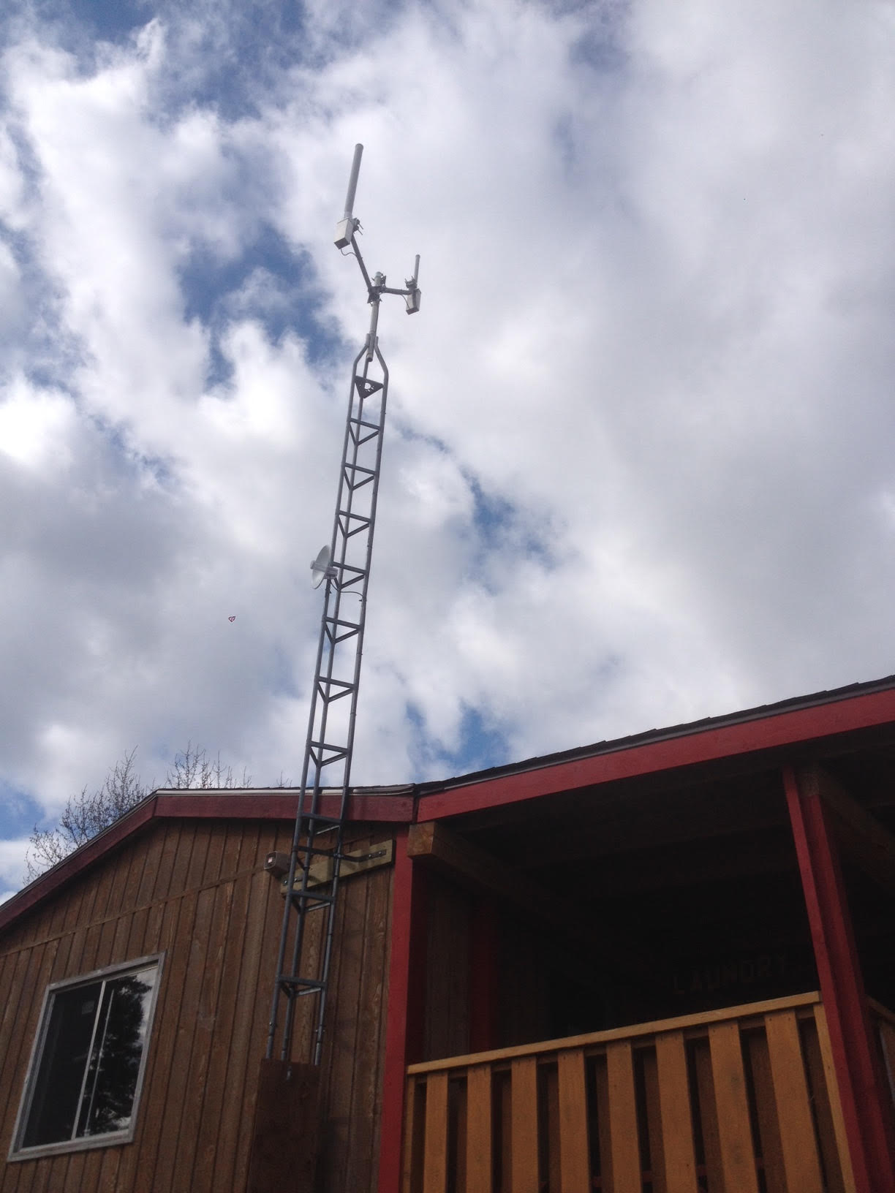
Tower mount on house

Slide 13
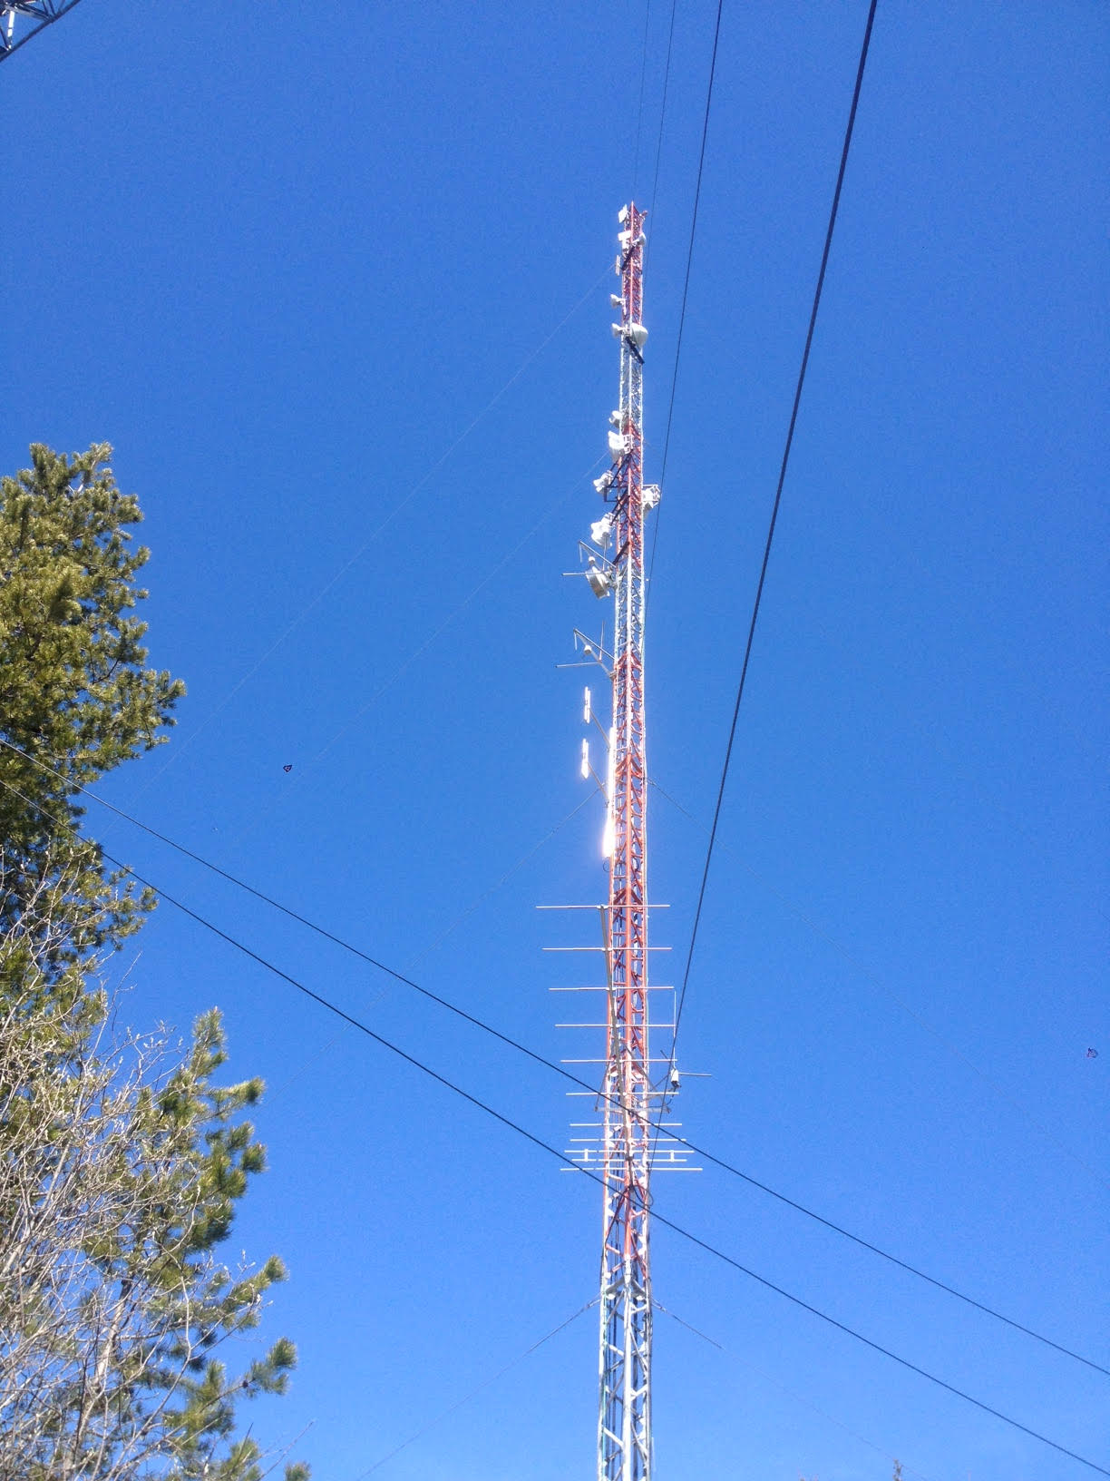
Kcr tower

Slide 14
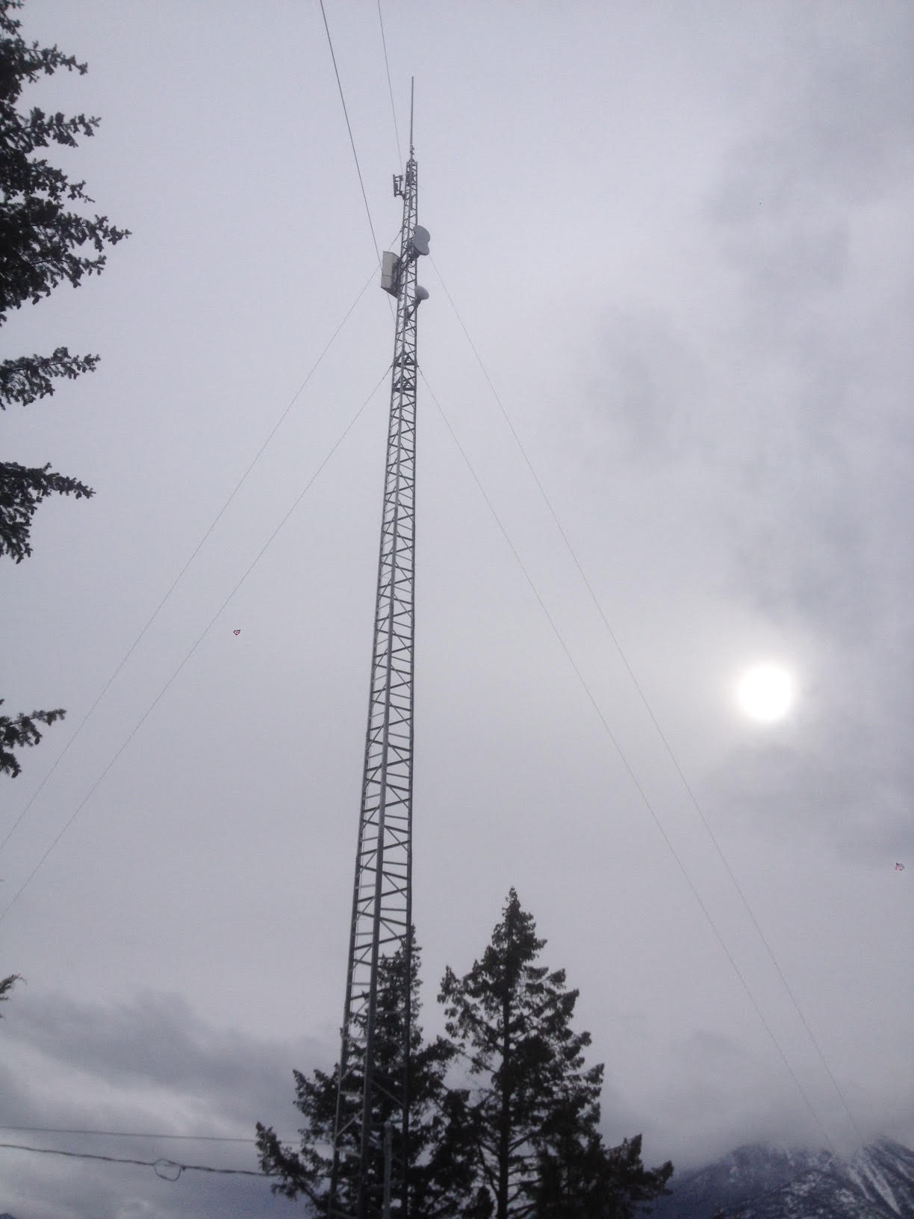
Clr tower

Slide 15
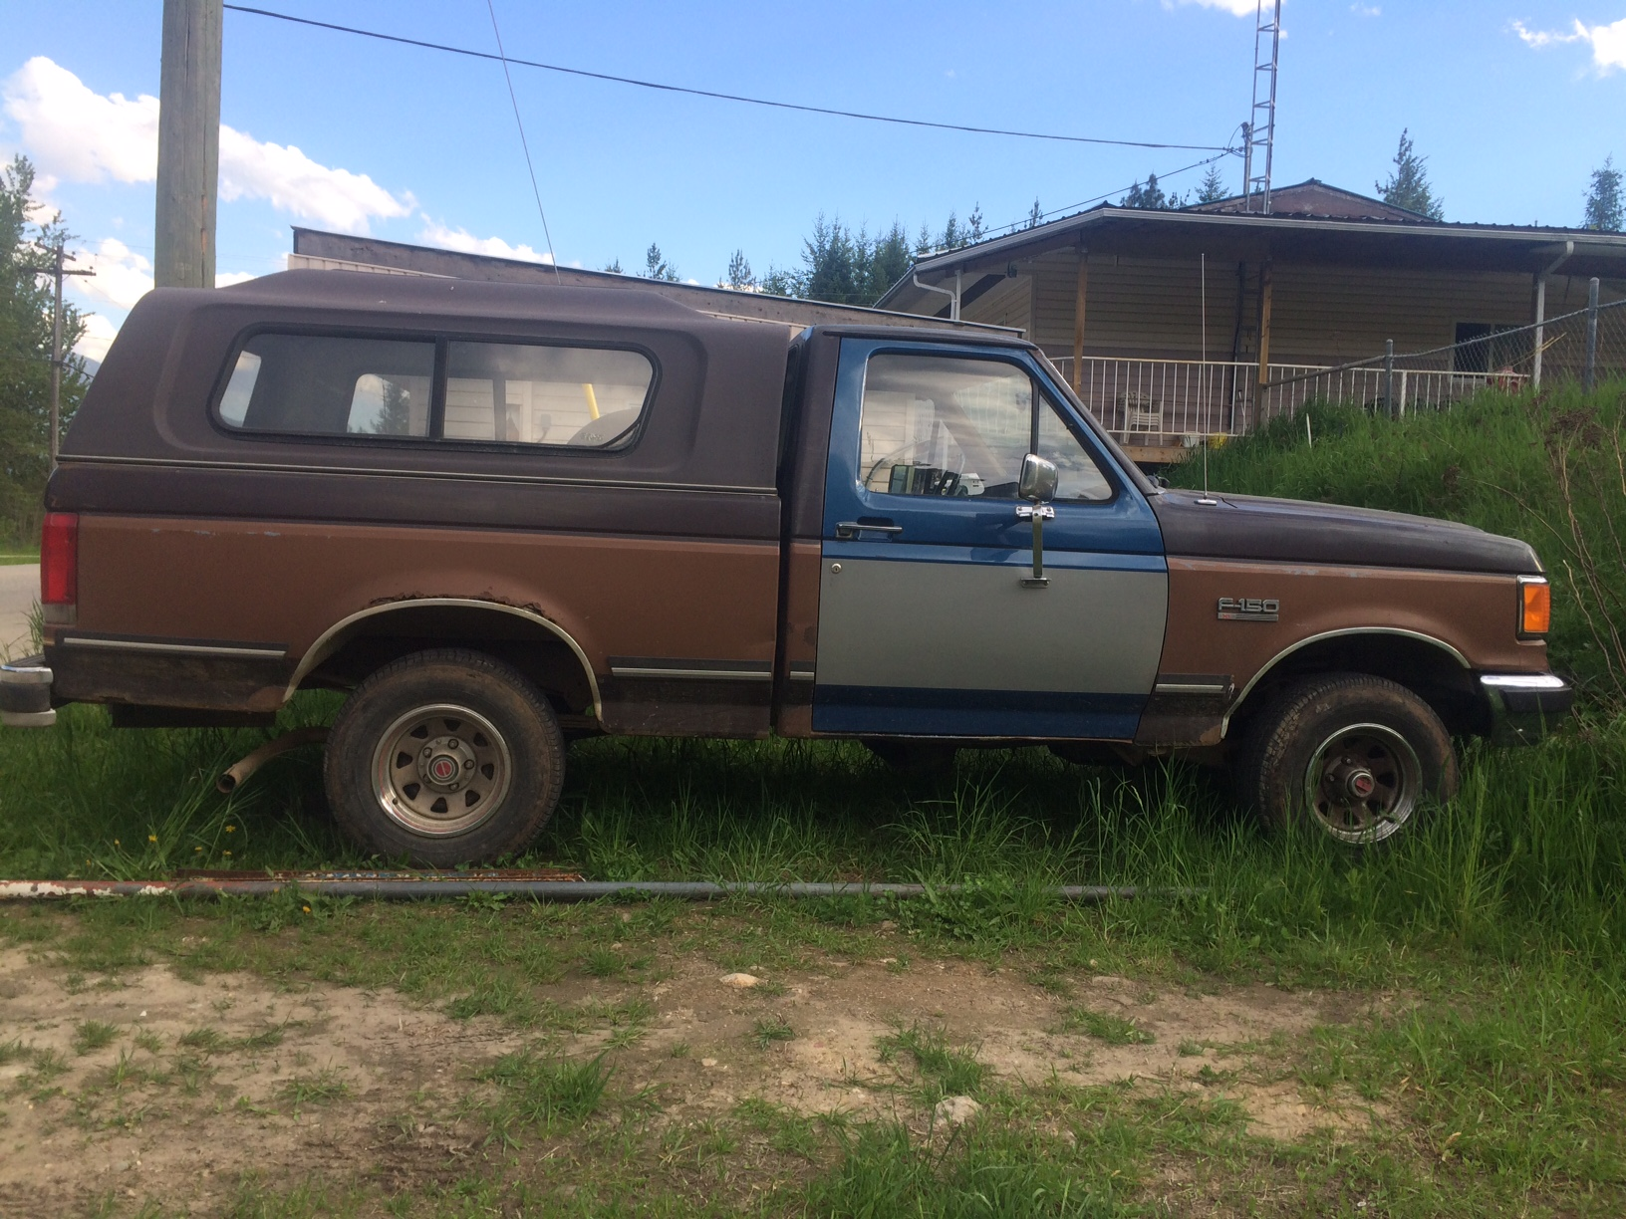
SIMON HANN DONATION

Slide 16
Now what has the board been doing

Slide 17

Not sleeping I can assure you

Slide 18
2016 agm promise to review pAkAgAEs every 4 mONths
Oct. 2016 increased data on all pkgs by 5-10 gb
Reduced overage fee FROM $1.50 TO $1.00 per gb
Nov. 2016 increased speeds on all pkgs – VARIED BY PKG.
JAN 2017 DATA INCREASED ON ALL PKGS

Slide 19


Slide 20
Apr. 2017 Increased data and speeds to all pkgs
Package | Cost/Month | NEW Speeds | NEW Monthly Data
Bronze | $50 + Tax | 5Mbps down / 1.5Mbps up | 100 GB
Copper | $70 + Tax | 6Mbps / 2Mbps | 150 GB
Silver | $90 + Tax | 8Mbps / 2.5Mbps | 300 GB
Gold | $110 + Tax | 12Mbps / 3Mbps | 400 GB
Platinum | $155 + Tax | 15Mbps / 3Mbps | 600 GB
High Volume Platinum | Call for Pricing | 15Mbps / 3Mbps up | 600+ GB

Slide 21


Slide 22
Questions?

Slide 23
LAST YEAR
THE AWAY CHARGE WAS LOWERED IN FEB. TO $5

Slide 24



Slide 25

APRIL Esis raises away rate to $20

Slide 26
Over 60 subscribers leave for 4-6 months each winter
RESULT IS CASH FLOW IS SIGNIFICANTLY IMPACTED

Slide 27
BREAKDOWN OF AWAY RATE COST
RADIO RENTAL COST $10
TECHNICAL & ADMIN. FEES $10
EXTENDED DURATION > 5 MTH MAX. $100

Slide 28
Remember
You can put your system on away
At any time for $20/mth
Going away for a minimum of a month to a max 8 months
Call first and put your system on away

Slide 29

FURTHER IMPROVEMENTS TO COME

Slide 30
Questions?

Slide 31
ESIS MEMBERSHIP
& DUES
CHANGES ARE NEEDED

Slide 32
ESIS CONSTITUTION

Slide 33
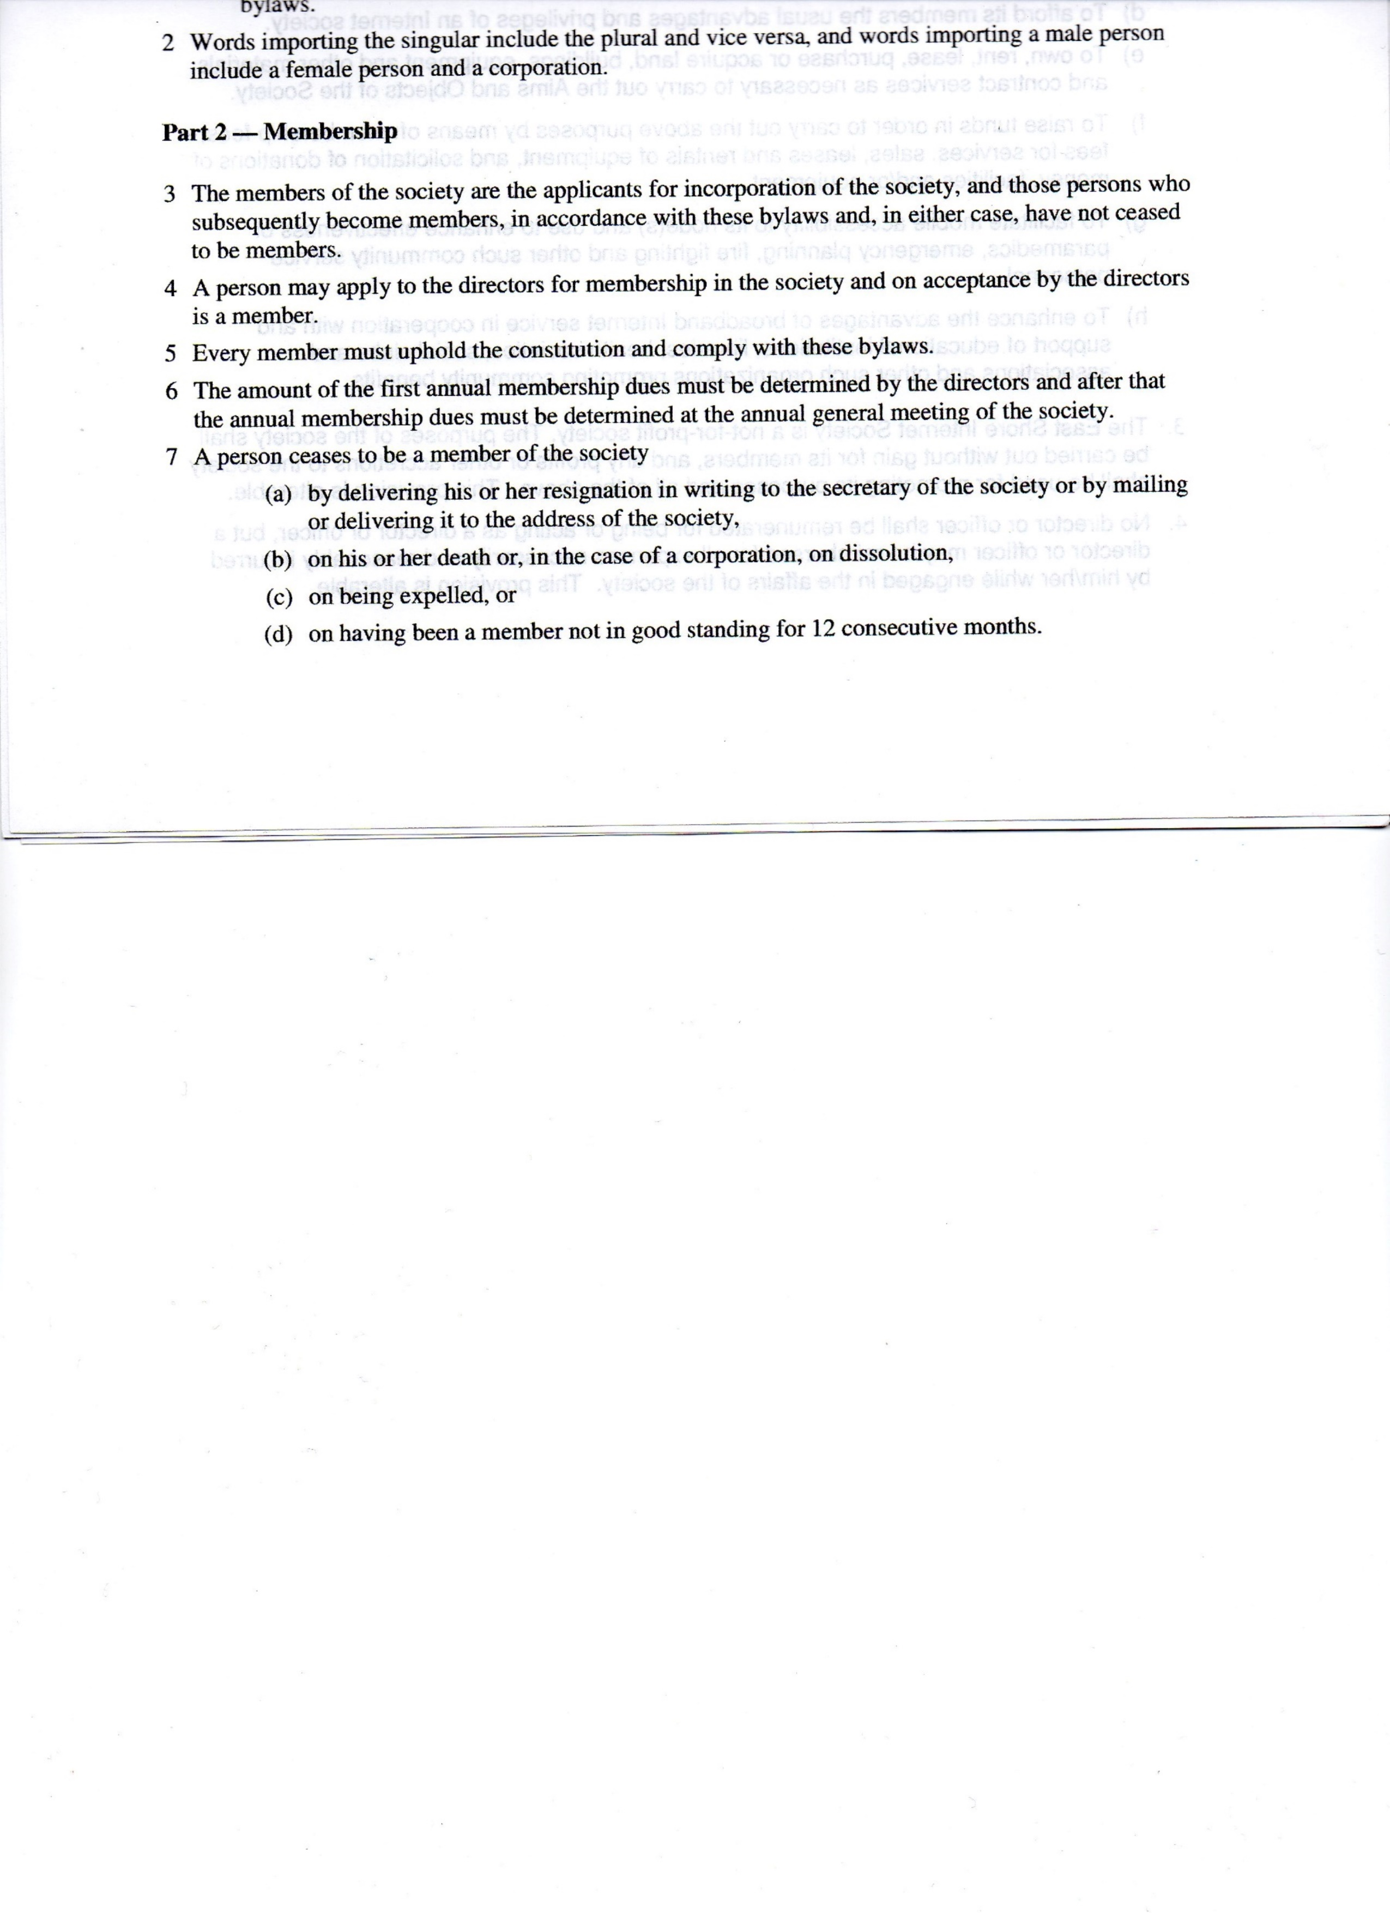

Slide 34
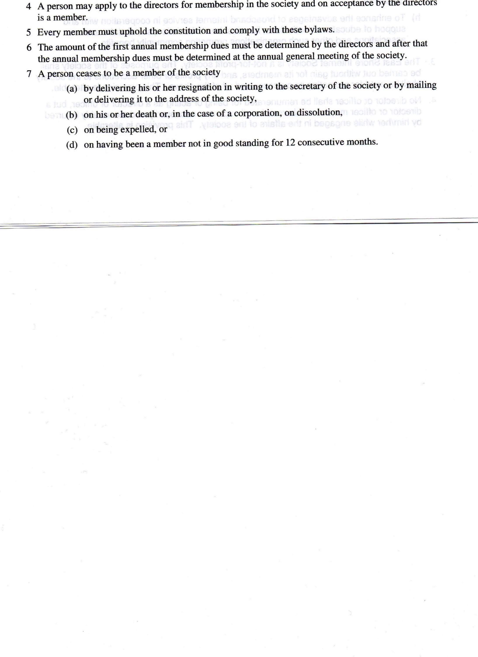

Slide 35

AS IT STANDS WHO CAN VOTE?

Slide 36

Everybody who has ever paid once?

Slide 37

Only subscribers?

Slide 38
RECOMENDATION
Stick to the constitution with yearly membership
All subscribers must be members – charged yearly
Non subscribers may be members by paying yearly
Suggested yearly membership renewal charge $5
Only subscribers in good standing may vote

Slide 39
Questions?

Slide 40
2016 FINANCIAL STATEMENTS

Slide 41
Questions?

Slide 42
CONNECTING CANADIANS
PROJECT UPDATE

Slide 43
Connecting Canadian Project
3-year project:
2015–2016 2016–2017 2017–2018
13 Internet Service Providers under guidance of Columbia Broadband Corp (CBBC)
Initial Grant money was delayed until February 2016 – procurement and construction schedule still expected to be met. ESIS Board and staff met the challenge.
March 31, 2017 end of 2nd phase. On schedule. 18 sites upgraded, tested and functional.

Slide 45
Connecting Canadian Project (cont’d)
320 out of 325 subscriber upgrades complete, 5 remaining waiting for seasonal subscriber returns
Some sites hidden in the trees remain challenging; doing our best to achieve best signal possible.
Timeline: Third phase April 2017 to March 2018. Expect to complete by December 2017

Slide 46
Connecting Canadian Project (cont’d)
3rd phase of project – new and upgrade of 5 sites:
  Kokanee Springs – new tower
  Russ Anderson – upgrade to tower
  Queen’s Bay – new site to serve Pilot Bay and potential new subs in Proctor area
  Woodbury Resort and Village area – already functional (April 2017)
  New mast to improve Fish Hawk signal

Slide 47
Connecting Canadian Project (cont’d)
New Technology improvements – subject to new funding likely from Fed
  Potential CRTC announcement in the works?
  Fibre and new radio technology, LTE, 5G, etc. will be looked at.

Slide 48
Connecting Canadian Project (cont’d)
Success from the work of many. Initiative and dedication of our staff and many hours invested by the Board and members of the local community.
Many thanks to all of you
for helping us get this far.

Slide 49
Questions?

Slide 50
Formal Business
CHANGES + Directors

Slide 51
The Board of Directors of the East Shore Internet Society recommends the following changes to the Bylaws of the East Shore Internet Society, each amendment to be voted on by the General Membership at the Annual General Meeting held today, May 23, 2017.

Slide 52
CHANGE 1
Be it resolved that:
In order to provide continuity of experience and expertise to the East Shore Internet Society Board of Directors, half of the director shall stand for one year term and half shall stand for a two year term at the Annual General Meeting to be held on May 23, 2017. Thereafter the Board of Directors will be elected to a two year term.

Slide 53
CHANGE 2
Be it resolved that:
The number of Directors for the East Shore Internet Society shall be set a minimum of three and a maximum of ten permanent Directors.

Slide 54
CHANGE 3
Be it resolved that:
Voting by proxy will not be allowed at the general meetings of the East Shore Internet Society.

Slide 55
CHANGE 4
Be it resolved that:
The annual renewal fee for membership in the East Shore Internet Society shall be $5.00. The renewal fee will be included together with the January service invoice for each year subsequent to joining the East Shore Internet Society.

Slide 56
CHANGE 5
Be it resolved that:
Voting at the annual general meeting of the East Shore Internet Society will be restricted to those active subscriber members whose account is in good standing. Non active and delinquent member shall not have the right to vote on special resolutions impacting the active subscriber members.

Slide 57
CHANGE 6
Be it resolved that:
The Board of Directors of the East Shore Internet Society may appoint at their discretion, a maximum of five interim director, to represent new areas of service as provided by the East Shore Internet Society or areas of needed expertise not currently available within the Board. The term of the Interim Director shall be until the next Annual General Meeting of the East Shore Internet Society.

Slide 58
ELECTION OF DIRECTORS
Be it resolved that the following slate be elected to the Board of Directors:
  Richard Bertram
  Dave Blair
  Ivy Jeffery
  Garth Norris
  Fraser Robb
  Rose Strom

Slide 59
Special Thanks
We would like to say a special thank you to our outgoing Board Members:
Mel Gale
Brian Philp
Dan Séguin

Slide 60
SEE YOU NEXT YEAR!

